Slide 1
CUSP GEANT4 status
Giovanni De Cesare February 7 2024

Slide 2
Items lists
Done (results stored in the shared Google Drive GEANT4CUSP)
Basic tests of the Monte Carlo code
github repo organized with a directory (send_box) for user contribution (to avoid conflicts)
Parallel 60 keV beam with 100 % polarized and unpolarized photons
Comparing unpolarized physic list with polarized with p = (0,0,0) -> same results, as expected
Point like 60 keV beam impinging on one detector (see the screenshot)
To Do (coming soon…)
Toy model (gdml integration)
Test of different physics list (as suggested by Riccardo)
Better organization of the archive and data (file naming, fit header, etc…)

Slide 3
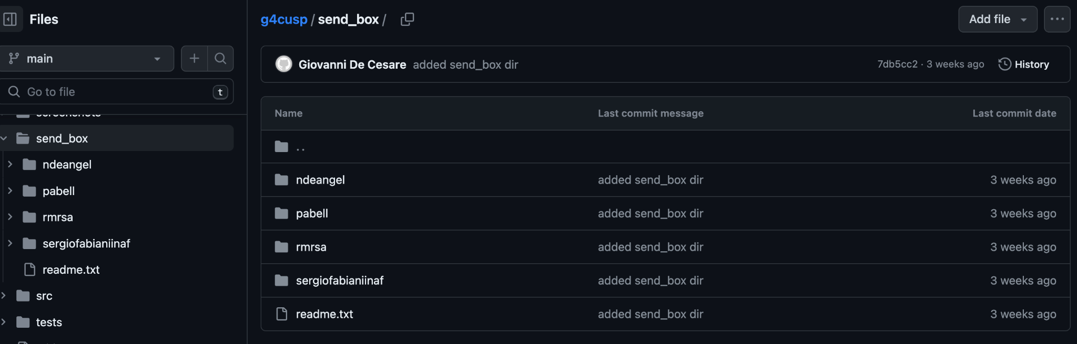
send_box github dir
https://github.com/giovixo/g4cusp

Slide 4
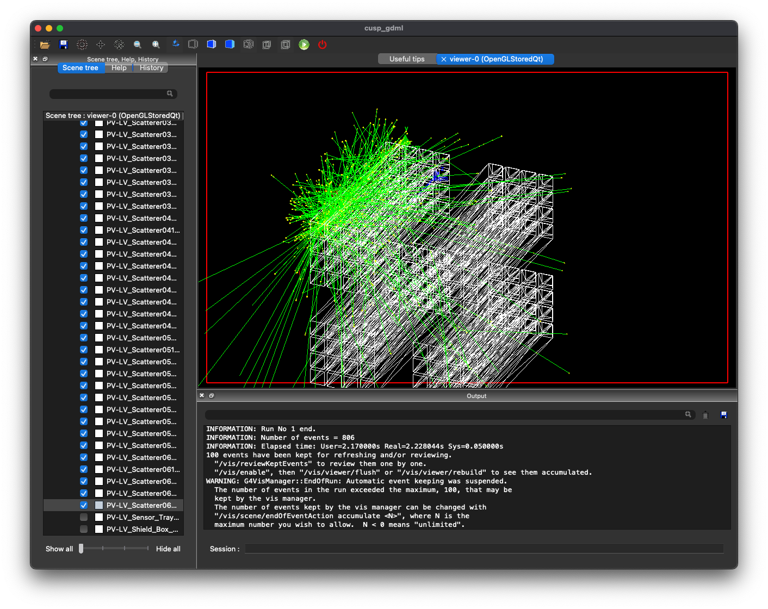
GEANT4 tracking: 60 keV photons point like beam

